Slide 1
AUTOMATED TOOLS FOR SYSTEM ANALYSTS

Slide 2
1.
INTRODUCTION

Slide 3
OUTLINE
0. Introduction
1. Data Gathering and Project Management Tools
2. Note Taking and Wireframing
3. Modeling/Visualizing Tools
4. Documentation/Presentation and Communication Tools
5. References

Slide 4


The Team!
Nusrat Jahan Urmi 161-15-6880
Md.Majedul Islam Rifat 161-15-6784
Md. Hafizur Rahman Arfin 161-15-7144
Tahera Koly 161-15- 6887

Slide 5
1.
Data Gathering and Project Management Tools
Nusrat Jahan Urmi 161-15-6880

Slide 6
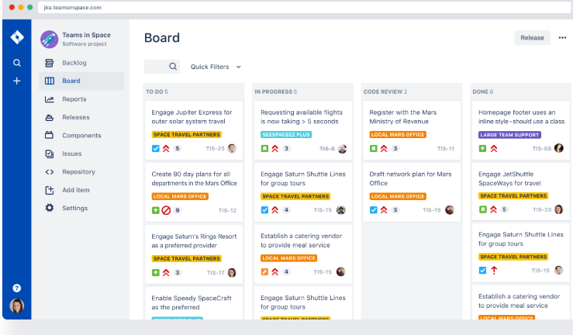

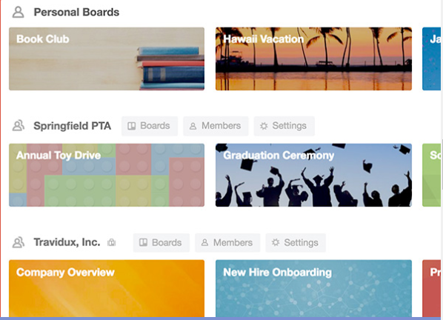
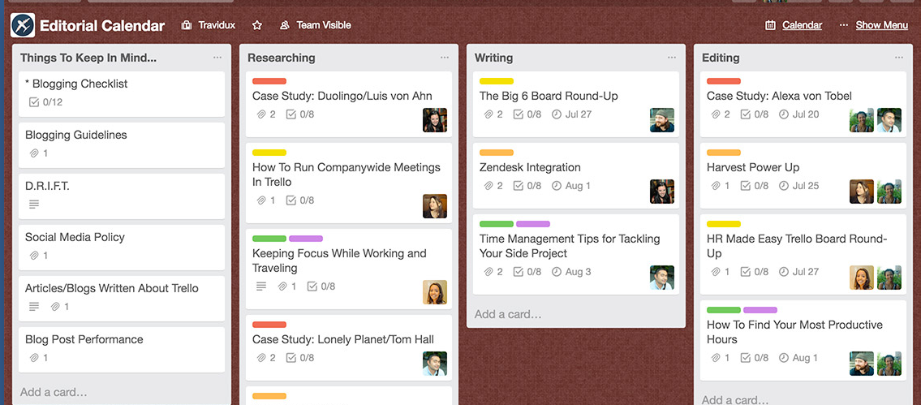
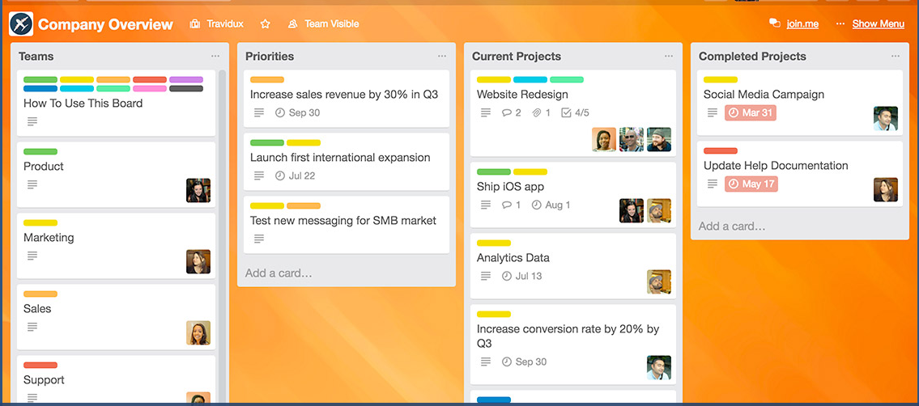
Project management
Jira
A proprietary issue tracking product
has been developed since 2002.
bug-tracking and project management include Fedora Commons, Hibernate, Twitter, Skype , Technologies, NASA,
written in Java.
Trello
a collaboration tool that organizes your projects into boards.
filled with lists of sticky notes
notes has photos, attachments from other data sources like BitBucket or Salesforce, documents, and a place to comment
can access it from any computer through the web

Slide 7
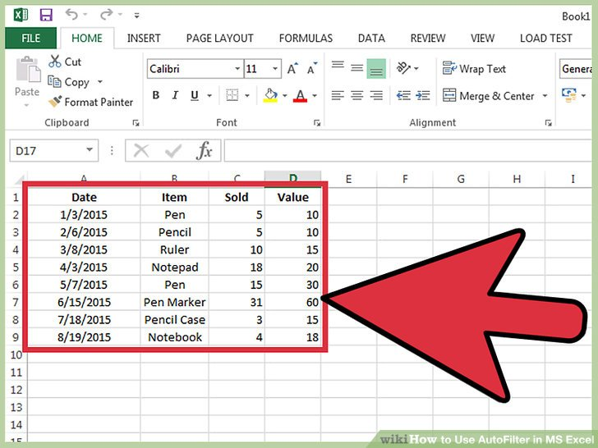
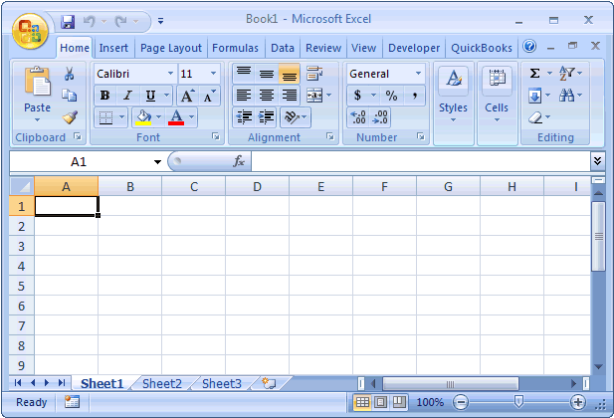
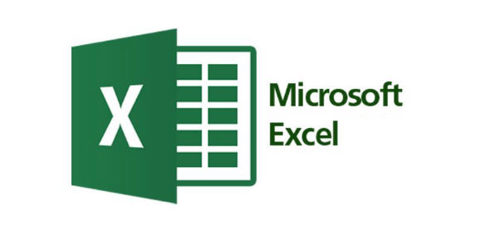
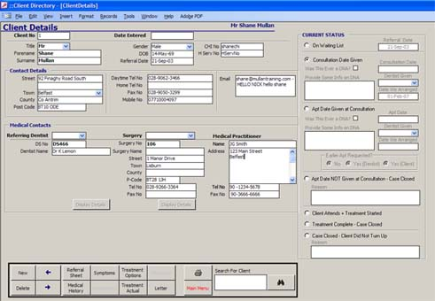
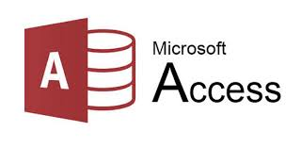
Data analysis
MS excel
a spreadsheet
Developed by Microsoft for Windows, macOS, Android and iOS.
a macro programming language called Visual Basic for Applications
part of Microsoft Office.
Microsoft Access
a database management system
combines the relational Microsoft Jet Database Engine with a graphical user interface and software-development tools.
can also import or link directly to data stored in other applications and databases.
use Microsoft Access to develop application software.

Slide 8
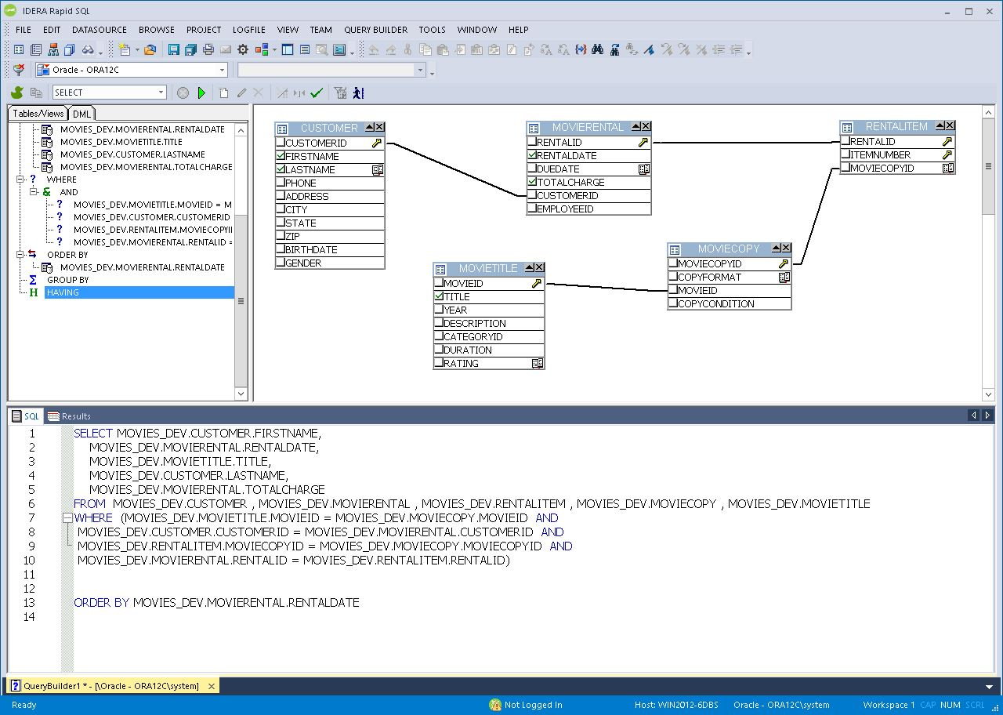
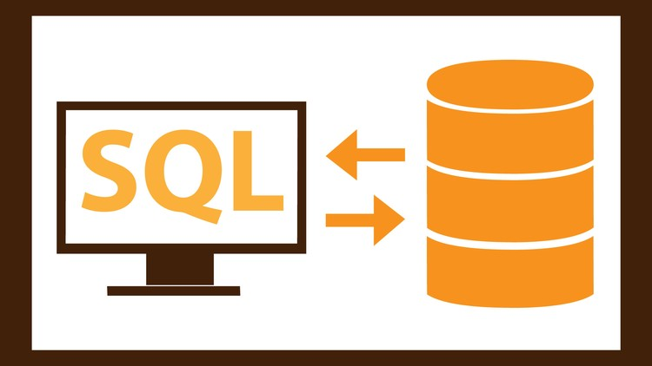
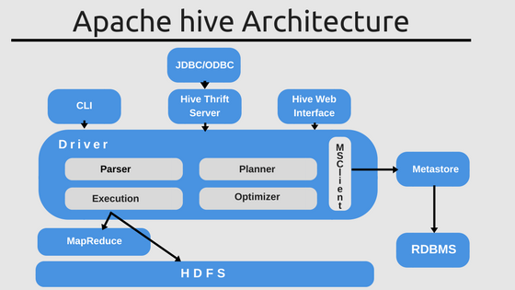

Extra Tools
SQL
a domain-specific language used in programming
designed for managing data held in a relational database management system
useful in handling structured data
based upon relational algebra and tuple relational calculus
Apache Hive
a data warehouse software project built on top of Apache Hadoop
providing data summarization, query and analysis.
portability of SQL-based applications
used and developed by other companies such as Netflix and the Financial Industry Regulatory Authority (FINRA).

Slide 9
2.
Note Taking and Wireframing
Md.Majedul Islam
161-15-6784

Slide 10
Note Taking, Wireframe or Mockup tools
What is note taking?
What is wireframe?
Why should use wireframe?
Visualize the general layout of a website or app
Build trust with the user and stakeholders
Save time and money

Slide 11
Note Taking,Wireframe or Mockup tools
What is mockup?
Why should use mockup?
Organize project details
Find errors early on
Translate ideas into a stakeholder language
Communicate ideas between team members
Design implementation
The user’s perspective

Slide 12
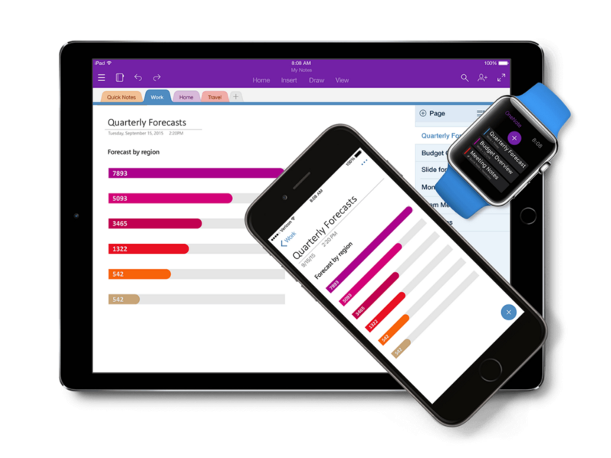
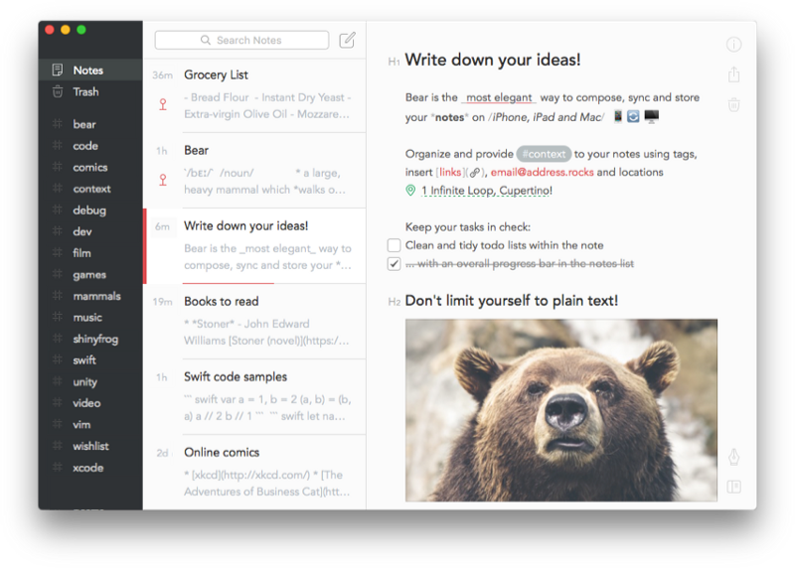
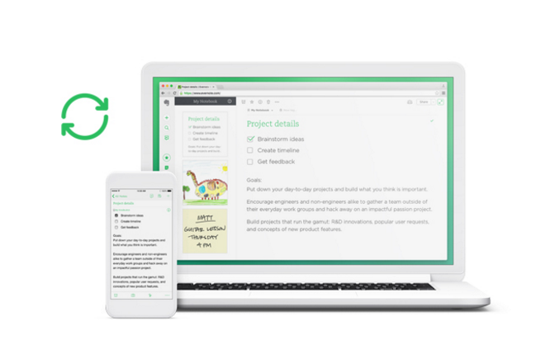
Note Taking
Evernote: evernote.com
Bear Notes: bear-writer.com
OneNote: onenote.com

Slide 13
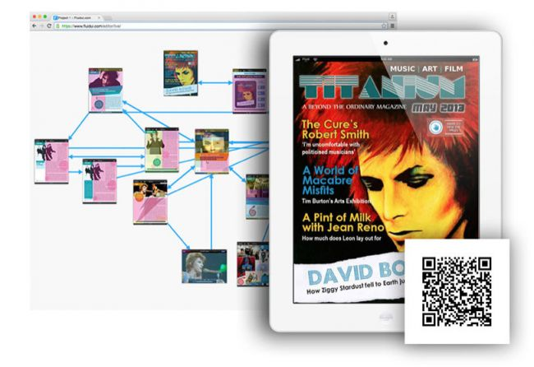
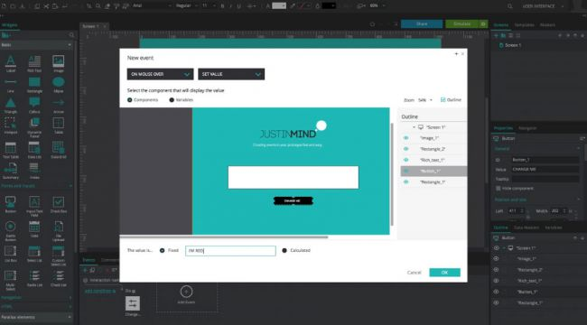
Wireframe tools
Justinmind :
Web-based Justinmind includes a library of UI elements, from buttons and forms to generics shapes and a range of widgets for iOS, SAP and Android. Custom styling is included.
Fluid UI :
Fluid UI has 16 built-in libraries for iOS, Android, Windows and more, and pages are created by dragging in elements from these libraries.

Slide 14
3.
Modeling/Visualizing Tools
Hafizur Rahman Arfin
161-15- 7144

Slide 15

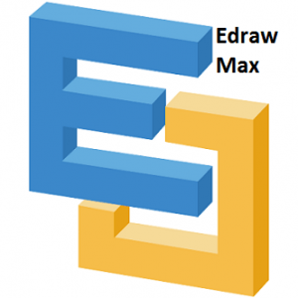
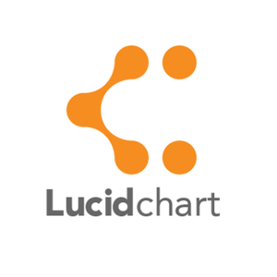
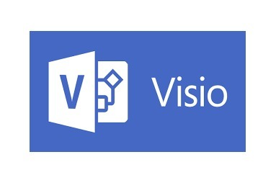

What is Modeling/Visualization Tools?
Tools that are used to model the system design in order to visualize, so the analyst can quickly see patterns in the data or possible relationships.
Common Modeling/Visualization Tools used by System Analysts:
Proto IO
Microsoft Viso
Lucid Chart
Edraw Max
FreeMind
https://proto.io/
https://products.office.com/en/visio/flowchart-software
https://www.lucidchart.com/
https://www.edrawsoft.com/edraw-max.php
http://freemind.sourceforge.net/wiki/index.php/Main_Page

Slide 16
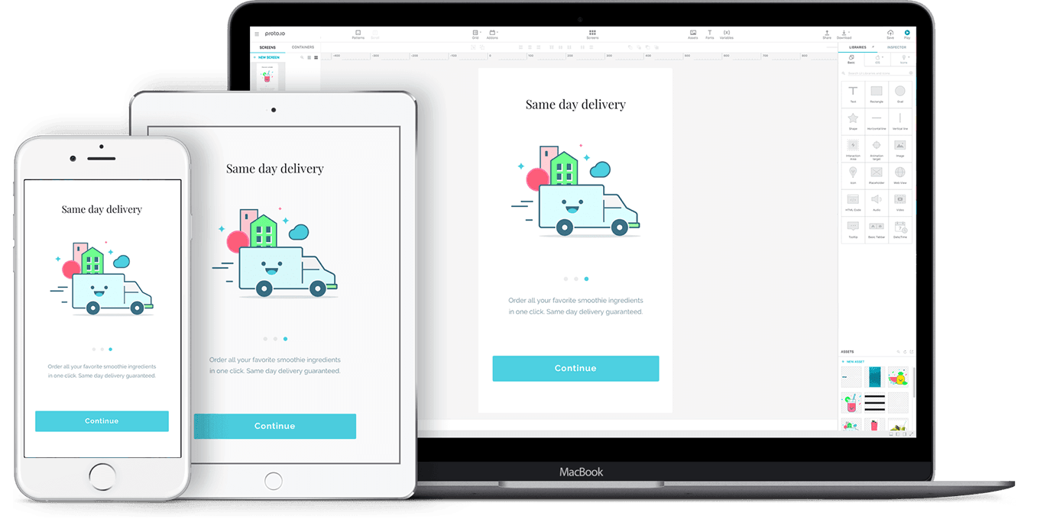
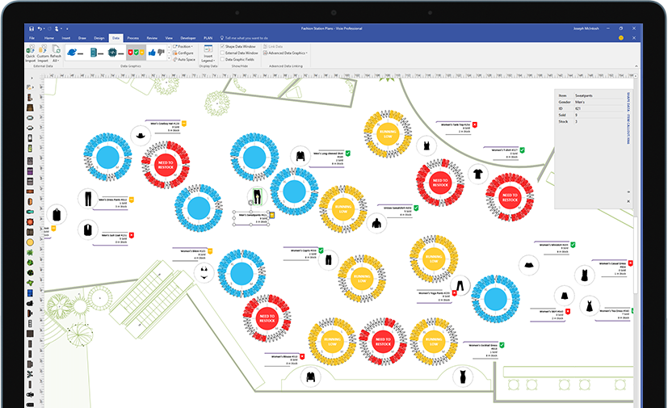
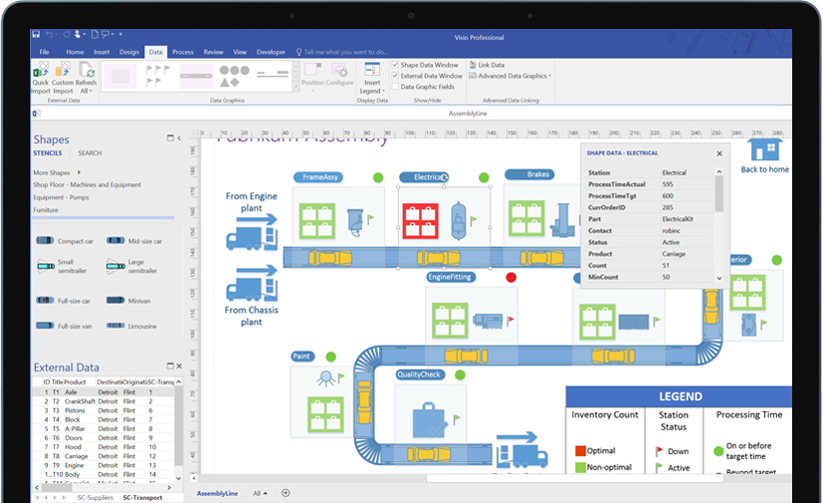
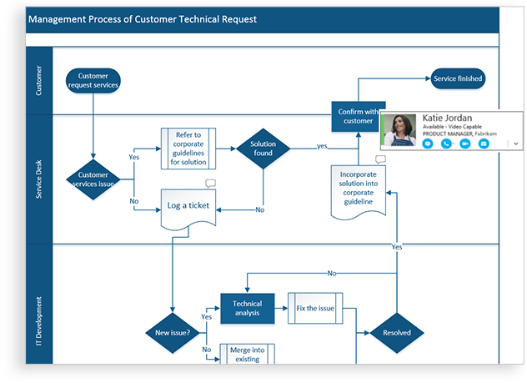
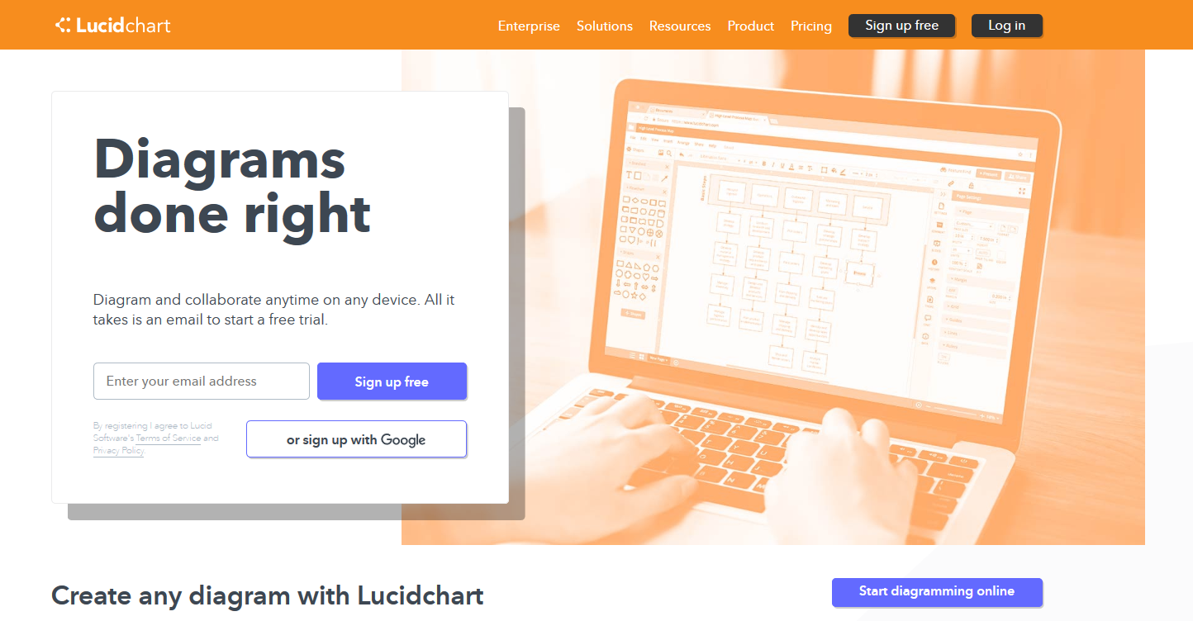
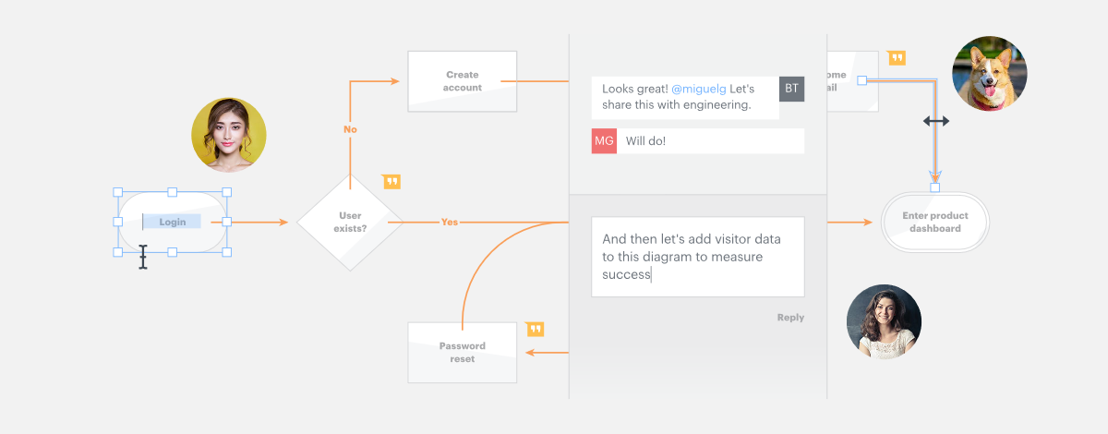
Modeling/Visualization Tools
1. Proto.io
Proto.io is web based prototyping tools for designing initial prototype for system
Drag and drop system for quiz workflow of analyst
Automated screen transitions and systems for real system feelings
No Coding required
Proto.io
2. Microsoft Viso
Paid Software made by Microsoft for Working visual diagramming.
Used by system analysts for plethora of works in everyday.
Create, manipulate, and share those diagrams faster.
Works seamlessly with other office products.
Intelligent features can predict and automate the process quickly
MicroSoft Viso
3. Lucid Chart
Free/Paid web service for crating diagrams.
Saves all diagrams and Data online. So easy access.
Online service so easy Collaboration with peers.
Updates frequently and new features are using data and machine learning for incrasing the workflow speed of a user.
LucidChart

Slide 17
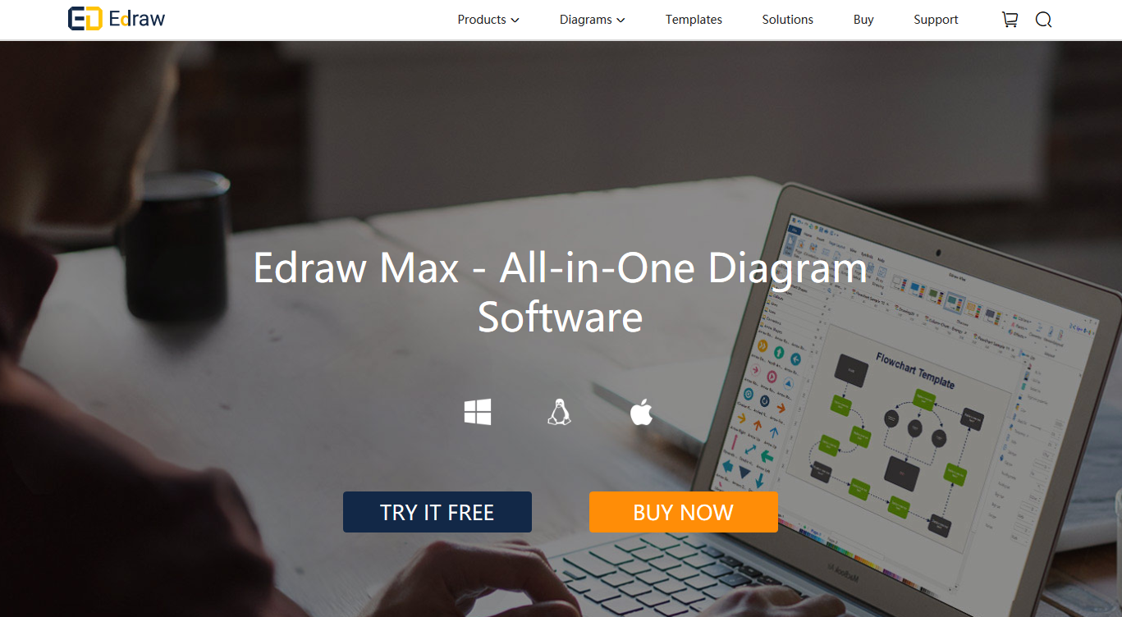
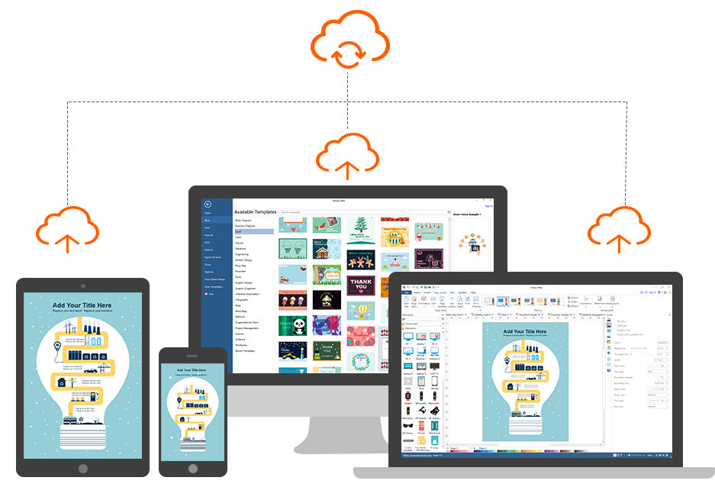
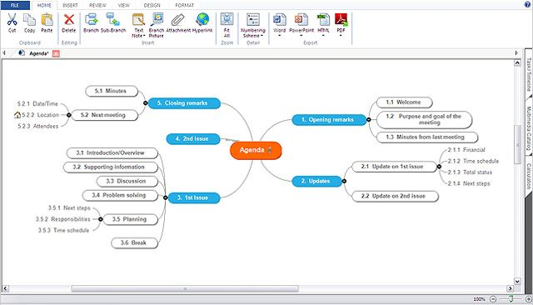

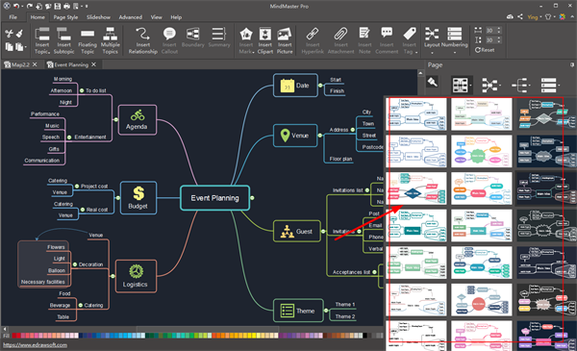
Modeling/Visualization Tools
4. Edraw Max
2D business technical diagramming software which help create flowcharts, organizational charts, mind map, network diagrams, floor plans, workflow diagrams, business charts, and engineering diagrams.
Multiplatform software supports Linux, MS and MAC.
A lot of free templates to automate the tasks
Fast and Intuitive Editing for diagram and visualizations
Widely popular among System Analysts
Edraw Max
5. FreeMind
FreeMind is a free mind mapping application written in Java. FreeMind is licensed under the GNU General Public License Version 2.
It provides extensive export capabilities..
Free and portable software used widely
Community Driven Mind mapping best tool
FreeMind

Slide 18
4.
Documentation/Presentation and Communication tools
Tahera koly
161-15- 6887

Slide 19
What is Documentation/Presentation tools:
Early educational instances of tools to present information involved lamp projection devices
Documentation/Presentation tools are:
1.MS word
2.Powerpoint
3.Jaspersoft
4.Tableau etc

Slide 20
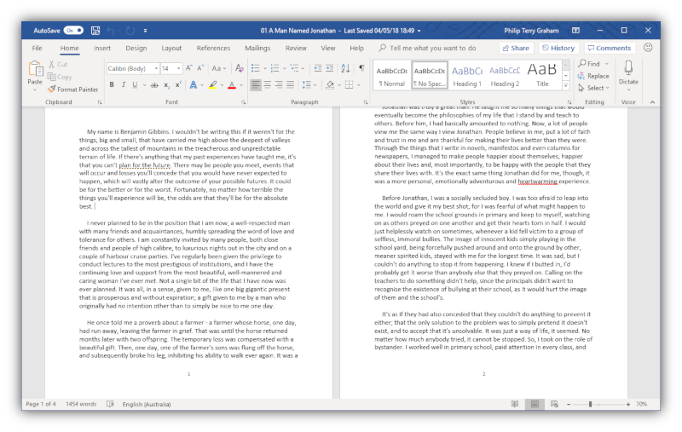
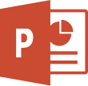
Ms word:
Word processor developed by Microsoft.
released on October 25, 1983
In 1981, Microsoft hired Charles Simonyi.
commonly used as the format for sending text documents
Powerpoint:
Microsoft PowerPoint is a presentation program
reated by Robert Gaskins and Dennis Austin
released on April 20, 1987
Microsoft's first significant acquisition,
designed to provide visuals for group presentations
Jaspersoft:
Teodor Danciu began work on JasperReports in June 2001
open source Java reporting tool that can write to a variety of targets
can be used in Java-enabled applications

Slide 21
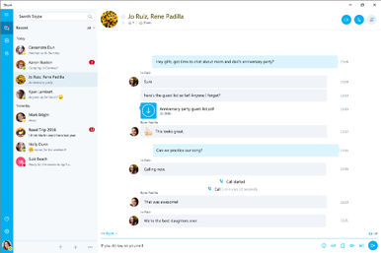
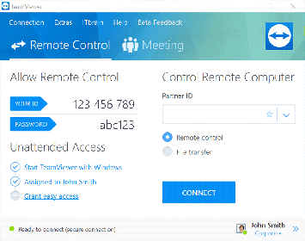
Communication and collaboration tools:
Skype :
telecommunications application software product that specializes in providing video chat and voice calls
provides instant messaging services.
Users may transmit both text and video messages
exchange digital documents such as images, text, and video
Team viewer:
remote control, desktop sharing, online meeting, web conferencing and file transfer between computers
available for Microsoft Windows, macOS,Linux,Chrome OS,Android
can be used without charge by non-commercial users

Slide 22
References
1. The Top Test Automation Tools: Two Analysts' Opinions https://dzone.com/articles/the-top-test-automation-tools-2-analyst-opinions
2. 21 Best Business Analysis Tools for BA Analyst (2018 Update) https://www.guru99.com/business-analyst-tools.html
3. System Analysis and Design – Overview https://www.tutorialspoint.com/system_analysis_and_design/system_analysis_and_design_overview.htm
4. Systems analysis and design https://en.wikipedia.org/wiki/Systems_analysis_and_design

Slide 23
Thank you
Any Questions?...

